Slide 1
DTMO Path Analysis Mid-Engagement Check In
September 6, 2018
Notes:
Lead by: Eddie

Slide 2
Welcome
Activity | Time
Introductions and Timeline | 10:00
Summary kick off goals | 10:10
Summary of findings | 10:15
Finding: Website review and analytics | 10:20
Finding: Who are ours users? | 10:40
Finding: How does information flow? | 11:00
BREAK (10 minutes) | 11:20
Next Steps | 11:30
Adjourn | 11:45
Notes:
Lead by: Eddie

Slide 3
Goals for the day
Review our goals from our kick off
Report back early findings from user interviews and research
Develop a shared sense of our current state and final deliverables
Align on a plan for next phase
Notes:
Lead by: Eddie

Slide 4
Timeline
Kickoff / Background research
Problem Definition / User Interviews
Align on opportunities / Follow on research
Synthesis / Recommendations
Week 1-2
Week 3-4
Week 5-6
Week 7-8
We are here

Slide 5
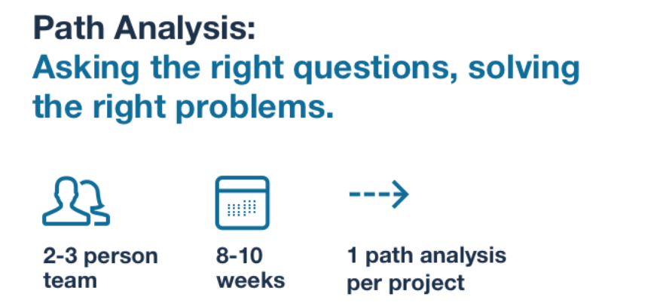
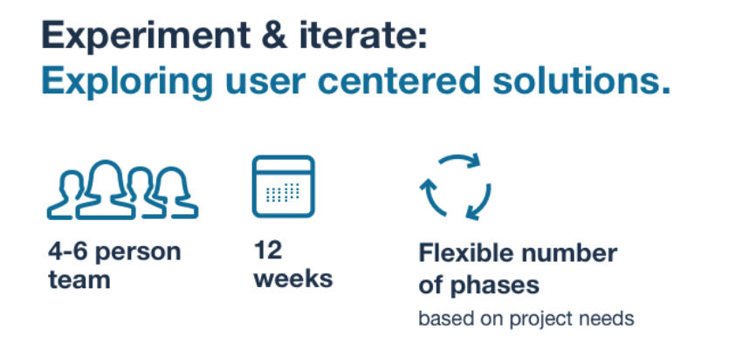
Engagement Timeline
Notes:
Lead by: Eddie
First, lets zoom out a bit
In Path Analysis: We want to make sure we’re asking the right questions. We are thinking of running a few visual experiments, but the building happens in next phase.
In E&I, we build enough to test in front of users

Slide 6
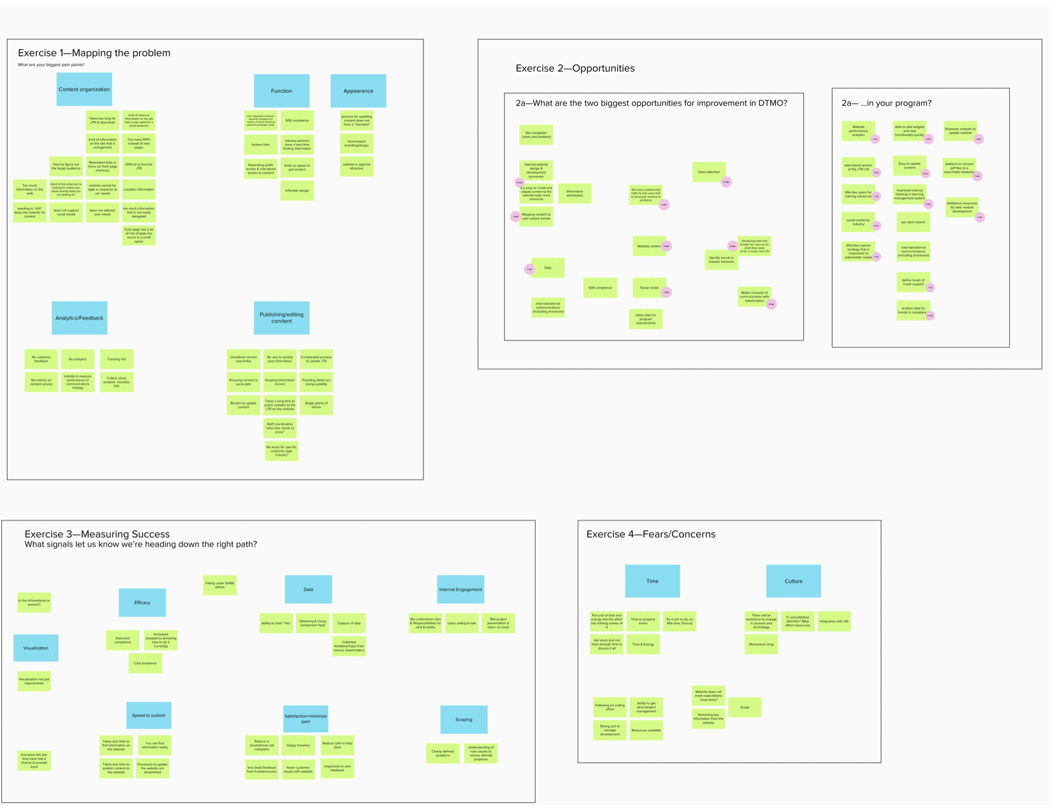
Kickoff Summary
Notes:
Lead by: Eddie
First, let’s review what we aligned on at our kick off meeting

Slide 7
The Problem
Users find it difficult to get the information they need from the DTMO website, especially since search does not work well, information on website can be out of date, and often buried inside PDFs.
Lack of user analytics means there is limited understanding of how audiences use the site.
Updating the content on the website is cumbersome.
The website has inconsistent branding and inflexible design.
Kickoff Summary
Notes:
Lead by: Eddie

Slide 8
Opportunities
Making it easy for DTMO staff to update the website.
Using site analytics to help identify problems and improve the DTMO website.
Providing DTMO users with a web-based version of the JTR .
Kickoff Summary
Notes:
Lead by: Eddie

Slide 9
Measuring success
Increasing customer satisfaction and tracking progress by reducing complaints and phone calls.
Requiring less time to update website.
Fears and concerns
Limited resources to accomplish a lot.
Concerns in scoping this effort.
Kickoff Summary
Notes:
Lead by: Eddie

Slide 10
Completed over 15 interviews with:
Travelers
Administrators
Auditors
Internal program teams
Reviewed analytics data, including:
Google Analytics
Travel Assistance surveys
Demographics report
Training numbers
Analyzed existing technology infrastructure
Mapped organization workflows
Our Approach
Notes:
Lead by: Eddie

Slide 11
Summary of what we’ve learned
and next steps
Note: This is a progress report of our thinking. Expect changes in final recommendations.
Notes:
Lead by: Eddie

Slide 12
The website structure is based on DTMO’s organizational structure rather than what users need.
Travelers are not the primary users — but are still important.
Travel administrators at every level need access to tools that will help them be more efficient when interacting with travelers.
Travelers depend on a wide range of travel support teams.
The process of updating the website is unnecessarily complex and causes delays in how information flows.
Summary of what we’ve learned
Notes:
Lead by: Eddie
Other points:
Travelers are looking for calculators and other tools to estimate costs
Travelers and administrators want to to quickly find policy and updates
Track site usage and create processes for continuous improvement
Allow for committees to discuss and make decisions for changes in policy
Experienced users are used to the inefficient structures of the site

Slide 13
What impact will the travel modernization effort have on training resources and ticketing systems?
Does DTMO have an organizational strategy to either focus on expanding the TAC or supporting the capabilities of the Services and Offices?
In regards to technology, are there related strategies that we need to align with?
What are the needs of the vendors (airlines, buses, car rental)?
What we do not yet know
Notes:
Lead by: Eddie

Slide 14
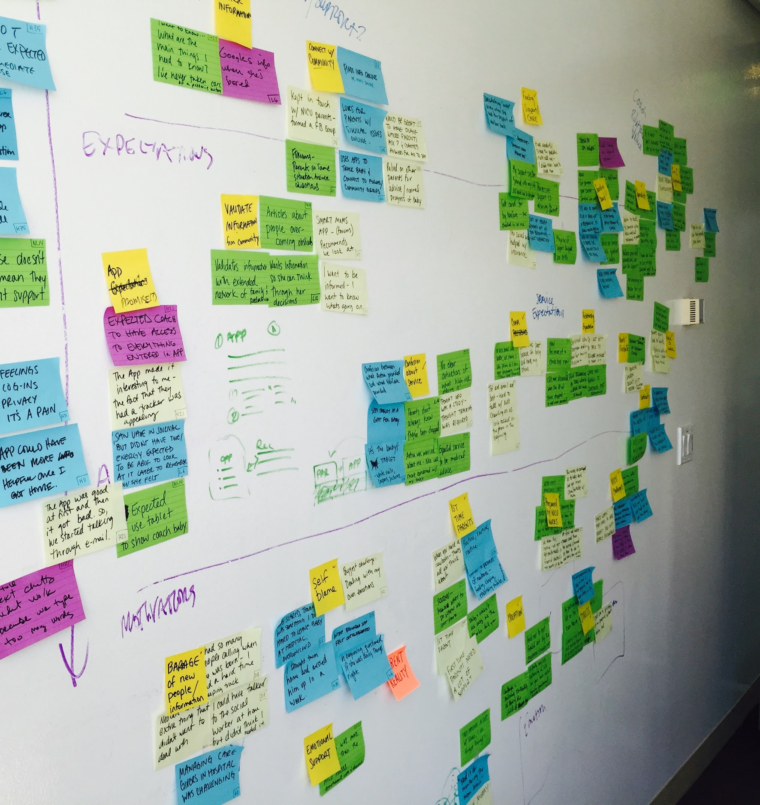
Foreshadowing next steps
Explore design concepts that reorganize the site’s navigation to prioritize content using the U.S Web Design System.
Explore using existing 18F tools to digitize and make the JTR interactive.
Align with DTMO’s strategy on travel support team, technology infrastructure and content strategy.
Notes:
Lead by: Eddie
Some of you won’t be around till the end, so here is a brief overview of what we are proposing are our next steps
What we want to start doing is laying the foundation for the next phase.
Next we will review our process and progress

Slide 15
How is the site being used?
Notes:
Lead by: Eddie to hand off to Cordelia

Slide 16
Site mapping: Building a high-level understanding of how the site is structured.
Analytics Overview: Quick and dirty analysis of the Google Analytics for 2018.
User Interviews: high-level interviews with different user groups to understand how they travel and use DTMO’s services.
Understanding the website and how people use it.
Notes:
Lead by: Cordelia
Reiterate that a lot of this is stuff that we already know.
Partially that is because the first part of a path analysis is for us to start understanding your world
Mostly this is about building a deeper understanding of the reality and testing the hypothesis that we laid out at the beginning.

Slide 17
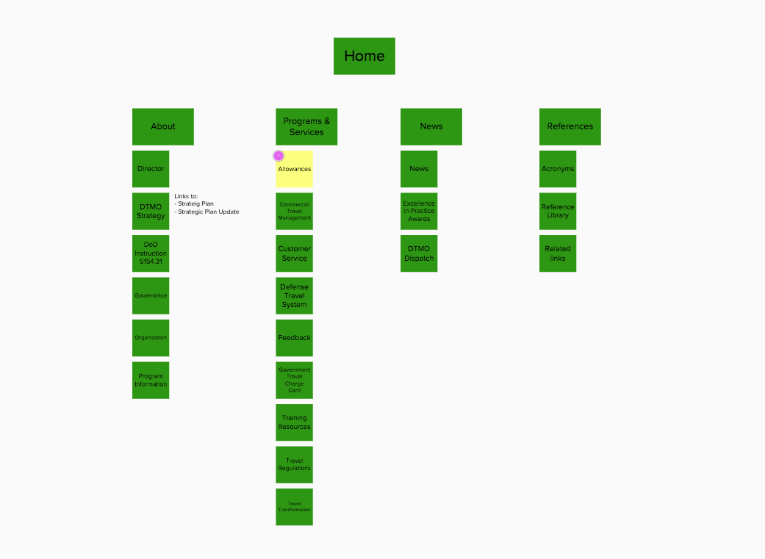
Current website structure
The structure of this website is based on how DTMO is organized rather than user need.
Notes:
Lead by: Cordelia
This is the top level of the global navigation of the DTMO website, which is to say this is the way you present your website structure to visitors.

Slide 18
The 50 most-visited pages
Notes:
Lead by: Cordelia
Checking the analytics for 2018, of the 50 most-visited pages, only three of them are in the global navigation.
And on average people visit 1.8 pages before leaving.
In our case that isn’t a necessarily a bad thing. Unlike commercial sites, DTMO’s value isn’t based on eyeballs. For us, knowing where their attention is helps us figure out whether we are serving their needs rather than how well our business is doing.
But to step back…

Slide 19
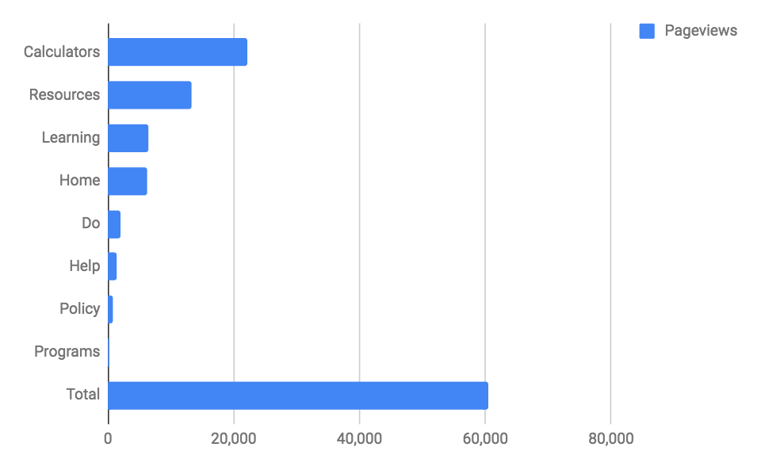
The 50 most-visited pages
87% of traffic goes to top 50 pages
36.7% of all traffic are to calculators
Only 10% of traffic goes to the home page
Notes:
Lead by: Cordelia
High-level notes
87% of traffic goes to top 50 pages
81% to top 25
66% to top 10
Calculators account for over 36% of all page views and nearly 40% of all unique views.
Housing Calculator accounts for 24% of *all* traffic
Per diem calculator accounts for 11%
Home page only accounts for about 10% of all views and only 12% of all entrances (the page people come to when they come to our site)—which means that most people don’t come to the DTMO website via the home page
This is part of a broader trend of how people use the web for most major websites, but also that is still extremely low which means that people do not find the home page useful.
Types:
Calculators = calculators
Resources = pages that link to resources (such as calculators
Learning = educational materials, FAQs
Do = TAC, DTS, &c
Help = Finding immediate support

Slide 20
“I use the calculators every day.”
—Tier 2 travel administrator
Notes:
Every travel administrator we talked to told us that were using the

Slide 21
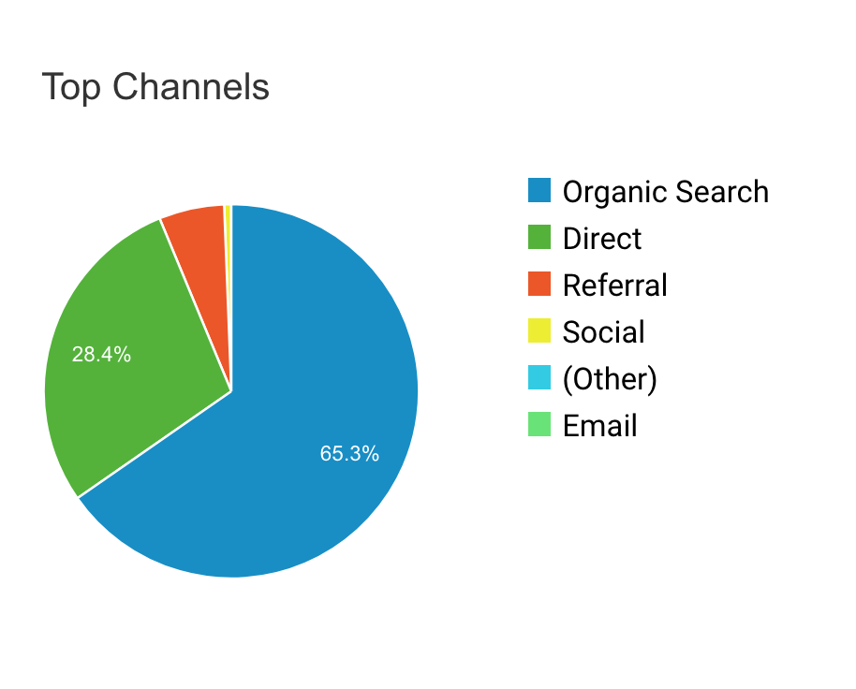
How people get here
65% from search
28% from direct links
Notes:
Lead by: Cordelia
High-level notes
67% comes from search.
28.4% directly
5% from direct referrals

Slide 22
“The site doesn't need to change, I know where everything is.”
“Yeah? How do you find things in the site?”
“I google it.”
—Every travel administrator
Notes:
Lead by: Cordelia
Every travel administrator we talked to told us that the site is perfect and doesn’t need to change.
They said that they knew where everything was.
They also said they went to google to get the links to all the things they use.
And that basically matches our site analytics.

Slide 23
What we can learn from this
The navigation isn’t serving people’s needs.
People are mostly coming to the website resources from elsewhere.
Notes:
Lead by: Cordelia
What we know
Users are not using the site navigation to find what they need.
A lot of them are coming straight to the page they need.
If they come to the home page, it seems like they’re probably giving up—over 72% of the people who come to the home page leave without going to another page.
A lot of the tools do not have google analytics on their results pages (which also open in new pages), so we do not have the full picture—a bit of this is inferring from time on page for particular tools.

Slide 24
The navigation isn’t serving people’s needs.
People are finding and coming to the website resources from elsewhere.
Only 10% of people visit the home page at all, and most of those leave without going anywhere else.
Major takeaways
Notes:
Lead by: Cordelia
Reassure people that these are common problems of old websites.

Slide 25
Who are our users?
Notes:
Lead by: Cordelia
Most travelers are not our users.
Travelers are our users only when something is off

Slide 26
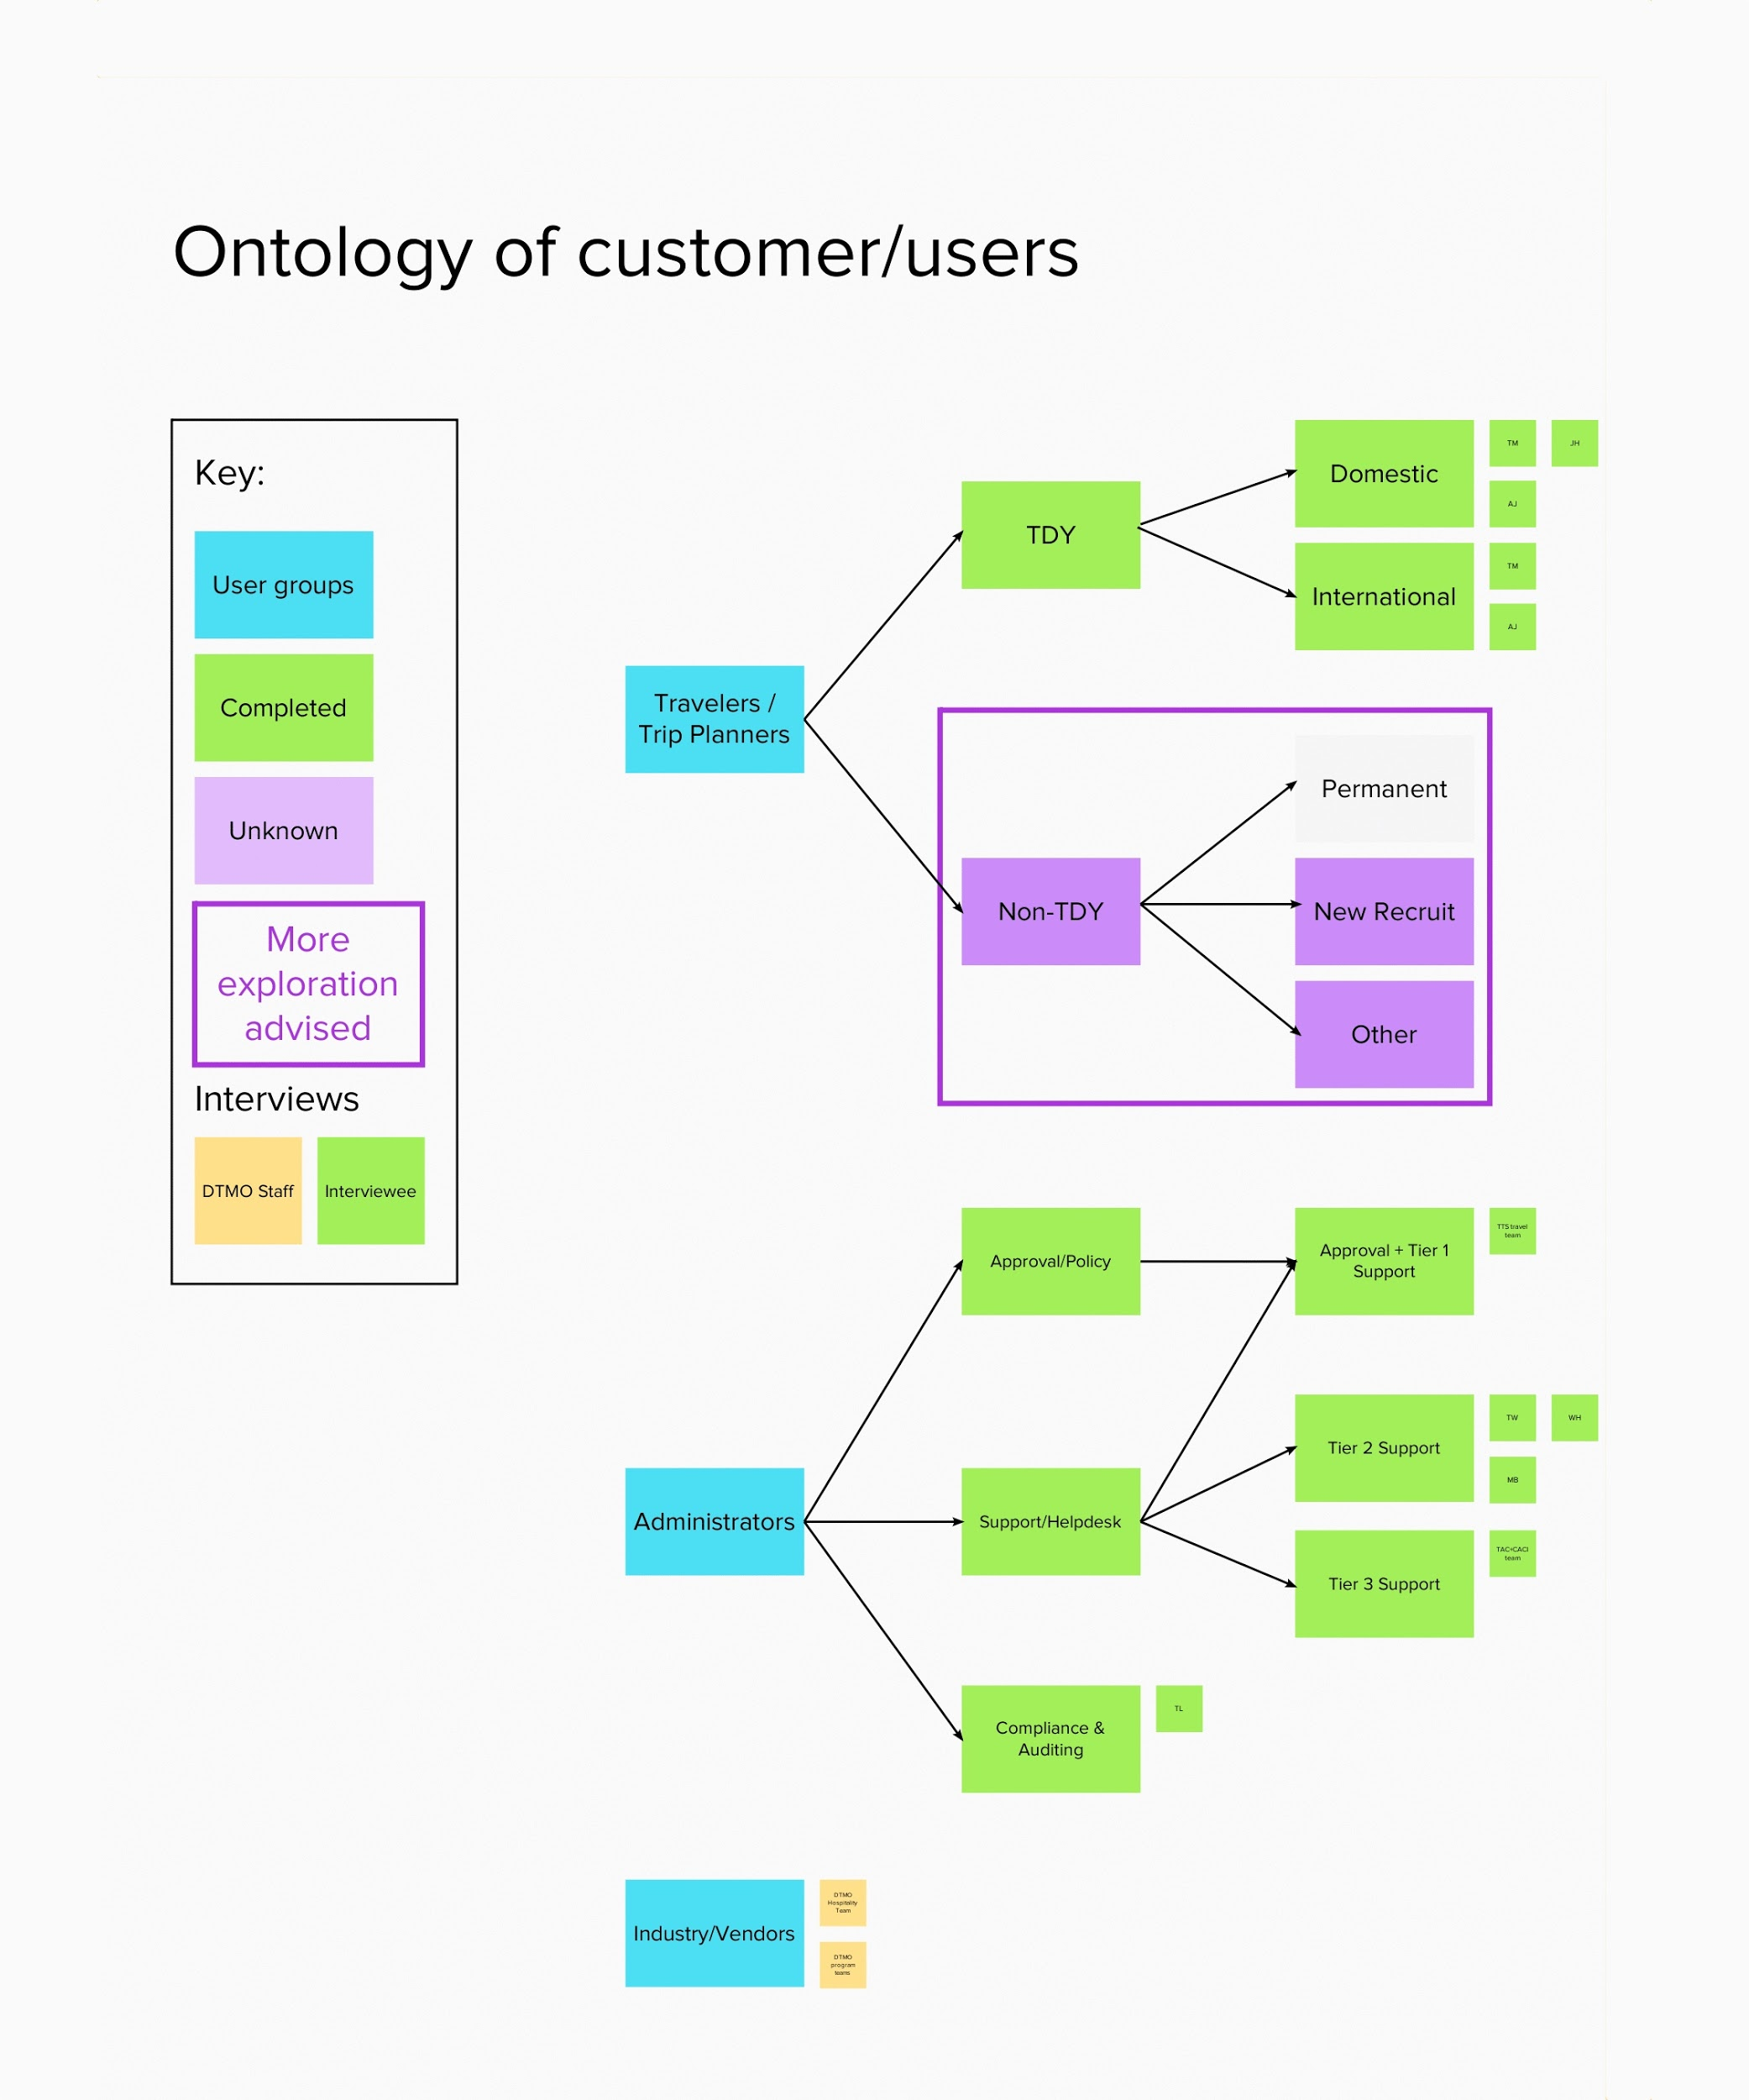

Primary Users
TDY
Non-TDY
Approval / Policy
Support / Help Desk
Compliance & Auditing
Travelers / Trip Planners
Administrators
Industry / Vendors
Notes:
Lead by: Cordelia

Slide 27
TDY
Non-TDY
Travelers / Trip Planners
Notes:
Lead by: Cordelia

Slide 28
For the most part, TDY travelers are unaware of DTMO’s resources.
Travelers / Trip Planners
Notes:
Lead by: Cordelia
The biggest theme we heard from travelers was they don’t really know about the travel regulations or particular resources from DTMO.
Two of them didn’t know anything about the Joint Travel Regulations and had never really looked at it. While they knew that regulations existed, and it governed the things they should be doing while traveling, they didn’t really know that those regulations mostly exist in a single document or that they could go find that regulation or why they would want to go use it.

Slide 29
But that’s mostly okay.
If they go to DTMO’s website, something’s weird (in their life).
Travelers / Trip Planners

Slide 30
I don’t know where to go to find answers and my office’s travel administrator is overworked, so I just don’t try.
—DoD traveler
Notes:
Lead by: Cordelia
The part where it breaks down is when the travel administrator isn’t able to provide support.
And sometimes they aren’t even available enough to push travelers to tier-2 support
This traveler mentioned having a problem with their voucher, and instead of going back to the administrator who is a contractor and where this work is part of the “other duties as assigned” part of their job description. So instead of going back to bother the administrator, they paid the discrepancy in their hotel lodging tax out of pocket.
And when I asked where they went to figure whether something was allowed, they didn’t know. They didn’t know there was a tier-2 support desk, or the TAC, nor did they know to go the JTR (or how to figure that out at all).
And for me, that was really eye opening because when we started, conversations around whether the TAC should take on more work or should we push people back down to tier 2 and 1 support, the more nuanced question might be:
How do we

Slide 31
Travel administrators
All tiers of support
Policy and compliance officers
Trainers
Travel Administrators
Notes:
Lead by: Cordelia

Slide 32
“I use the calculators every day.”
—travel administrator
Notes:
Lead by: Cordelia
Use the DTMO website every day.

Slide 33
“I’m always talking to other administrators to share best practices.”
—contract auditor
Notes:
Lead by: Cordelia
Oftentimes it’s more effective to find and nurture communities that already exist than it is to grow a communications channel new one from scratch—and since people are already finding their own people, one of the most effective

Slide 34
“I love the resources in Trax, I always share the trifolds with users.”
—theme from a few travel adminstrators
Notes:
Oftentimes it’s more effective to find and nurture communities that already exist than it is to grow a communications channel new one from scratch—and since people are already finding their own people, one of the most effective

Slide 35
Experienced, informed, and well-equipped travel administrators are the difference between an okay traveler experience and a great one.
Travel Administrators
Notes:
Lead by: Cordelia
The biggest theme we heard from travelers was they don’t really know about the travel regulations or particular resources from DTMO.
The really great travel administrators and support folks we talked to were not just using the resources DTMO provided (two mentioned *loving* the trifolds!), but also customizing them for their own needs and providing those resource to their travelers.
The less attentive administrators didn’t do many of those service type things. But it’s not because they’re not good at their job, but because they have so much else to do that they just aren’t able to stay on top of things.

Slide 36
Who’s missing?
TDY
Non-TDY
Approval / Policy
Support / Help Desk
Compliance & Auditing
Travelers / Trip Planners
Administrators
Industry / Vendors
Notes:
Lead by: Cordelia
The two major groups we have not had a chance to talk to yet are:
Those planning or on non-TDY travel
Vendors and folks in the industry
For now it feels okay that we don’t concentrate on vendors because during our conversation with the hospitality team and the folks who run the rental car and other programs that it seems to be a relatively high-touch relationship with a very small group of people.
But for non-TDY travel, we totally do not know how big of a deal that should be. At this moment our intuition is that it’s okay that we’ve concentrated on TDY travelers because that is probably the most common use case. But we will want to build some understanding of what sort of support structures are for those travelers before having a strategic redesign of the DTMO’s website and tools.

Slide 37
Other Users
Committee members
Intranet users
Others?
Notes:
Lead by: Cordelia
In the long term, as websites move we will have to understand the needs of these users—and i have a ton of thoughts on tools for collaborative decision-making—but they do not seem as pressing

Slide 38
Administrators are most likely to use and interact with DTMO’s resources.
Travelers rarely directly interface with DTMO resources, unless they have nowhere else to go.
The most supportive administrators provide a lot of DTMO’s resources to their travelers, the least supportive ones often lack the time to be that comprehensive.
Major takeaways
Notes:
Lead by: Cordelia
Reiterate that a lot of this is stuff that we already know.
Partially that is because the first part of a path analysis is for us to start understanding your world
Mostly this is about building a deeper understanding of the reality and testing the hypothesis that we laid out at the beginning.

Slide 39
How does the organization support travelers?
Notes:
Lead by: Eddie
In a few of our conversations we heard that DTMO should service end travellers, or how much support should the TAC provide?

Slide 40
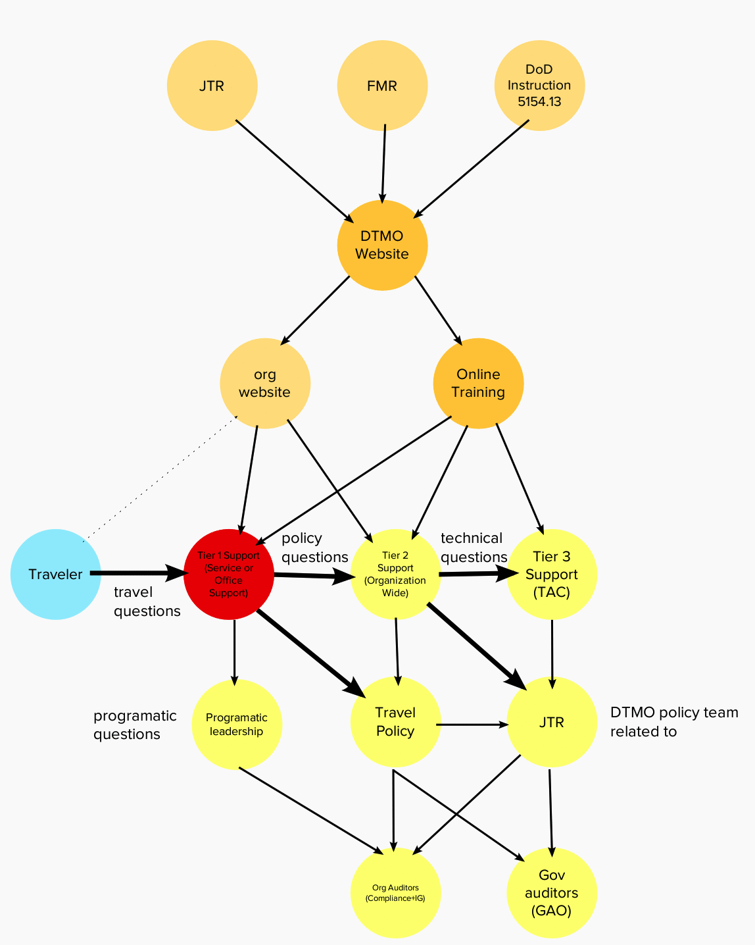
The complex web of interactions
Notes:
Lead by: Eddie
The way information flows within this organization. It’s not comprehensive, but shows a bit of how we’re seeing things.
This is an opportunity to let us know if this map seems accurate to you and make adjustments
We see there are two focus areas, the Tier 1 support and JTR resource

Slide 41
The complex web of interactions
Tier 1 Support (the traveler direct support team)
The front-lines for many travelers and often the widest range of quality.
Follow the Service/Office policies, which must comply with the JTR.
Have the least amount of training and least power to help travelers through problems.
May not necessarily their primary duty.
Notes:
Lead by: Eddie

Slide 42
The complex web of interactions
Tier 2 Support (Service-wide support team)
There is an emergent cross-agency support network.
They are the only ones with JTR knowledge and vision into service-level policy.
service-specific business rules, and DTS admin powers.
Notes:
Lead by: Eddie

Slide 43
The complex web of interactions
Tier 3 (TAC)
Often get policy questions, but they cannot provide interpretation.
The TAC is over overwhelmed with phone calls and average wait times are over an hour.
Most popular calls walk user through the authorization process.
Notes:
Lead by: Eddie

Slide 44
The travel modernization effort will require standardizing service-level policy.
The support teams at every level will have greater reliance on the JTR.
Creating a web version of the JTR that is easy to update, search, link to glossaries and external resources will be critical,
Major takeaways
Notes:
Lead by: Eddie
Regardless of what a herculean effort standardizing service-level policy is, the plan is that there are very minimal custom service-level business rules.

Slide 45
Next Steps
Explore design concepts that reorganize the site’s navigation to prioritize content using the U.S Web Design System.
Explore using existing 18F tools to digitize and make the JTR interactive.
Align with DTMO’s strategy on travel support team, technology infrastructure and content strategy.
Notes:
Lead by: Eddie and Cordelia
Front this presentation we see how important the JTR is to a broad range of travel administrators
How it impacts travelers
How we can prioritize the content users want
How we need to align with other strategic initiatives that are in place since this will have an impact on them

Slide 46
Explore design concepts that reorganize the site’s navigation to prioritize content using the U.S Web Design System.
Notes:
Lead by: Eddie and Cordelia
Discussion item

Slide 47
Explore using existing 18F tools (Federalist/eRegs) to digitize and make the JTR searchable and interactive.
Notes:
Lead by: Eddie and Cordelia
Discussion item

Slide 48
Align with DTMO’s strategy on travel support team and technology.
Notes:
Lead by: Eddie and Cordelia
Discussion item

Slide 49
Thank you!

